Slide 1



#SIH Hardware Edition – GRAND FINALE!!!
Team Members:
Shivani Suvatheka S
Al Mohamed Bilal A Raaja Kartikeya N S
Dinesh S
Ammu Nishitha S
Vishal Jonathan A
Team Mentors:
Mr V Karthick
Dr P Karthikeyan
Neo Matrixx
Velammal College of Engineering & Technology
Madurai
PS ID: UP1263
Organization Name:

Slide 2
Wireless pods & disposable patches to monitor the vital parameters of NEonates
- Taking the medical field to the next level using innovation & technology

Slide 3
Problem statement
To design and develop wireless pods & disposable patches to monitor the vital parameters of neonates
Category | Hardware
PS Number | UP1263
Organization | GE Healthcare
Domain Bucket | MedTech/BioTech/HealthTech
Team Name | Neo Matrixx

Slide 4
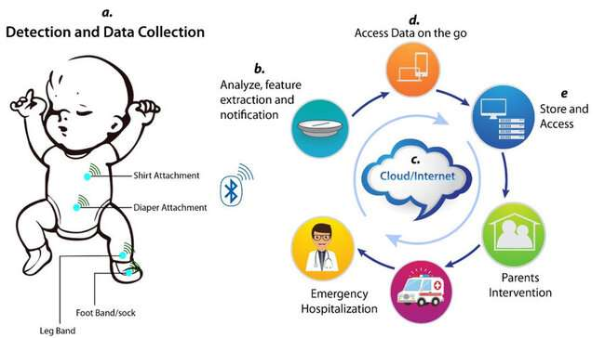

Developed idea before the final product
Design and develop wireless pods and disposable patches to monitor vital parameters of the neonate in NICU.
Suitable sensors are selected to monitor the vital parameters according to the clinical needs and specifications.
Vital parameters: Temperature, heart rate, SpO2, pulse rate, ECG, and sleep apnea

Slide 5
Progress - Day 1 (25.08.22)
Task Assigned | Struggles Faced | Outcome
Reconstruct the previously designed model before the 2nd round of filtration | Time Consuming, Informed not to bring the previously prepared model for the competition | Successfully reconstructed the previous module, Reduce & integrate the number of sensors that can monitor several parameters

Slide 6
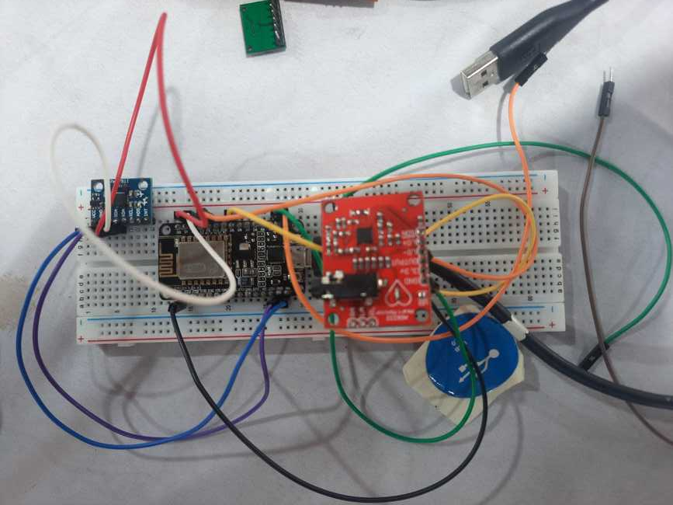
Continued…
MPU6050
AD8232
NodeMCU ESP8266

Slide 7
Progress – day 2 (26.08.22)
Task Assigned | Struggles Faced | Outcome
Obtain output for temperature & ECG | Error Handling in Code – A large number of errors compared to what we expected!!! | Obtained the output for temperature & ECG
Design a Printed Circuit Board(PCB) with the least dimensions as far possible | Limited knowledge of PCB designing, Absence of holes in PCB(after printing), Copper in the rest of the parts except the connection was not removed, Time consuming | Successfully designed a PCB board referring YouTube videos & EasyEDA software & Gerber file was generated

Slide 8
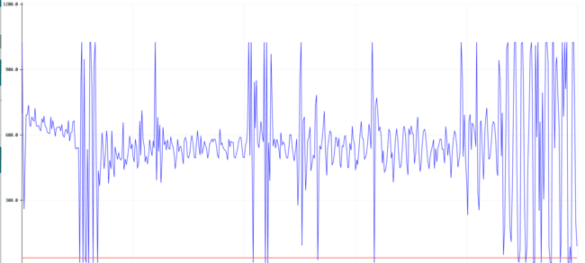
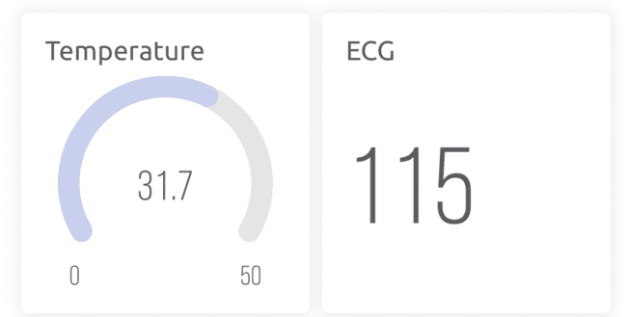
Output: ECG & Temperature

Slide 9
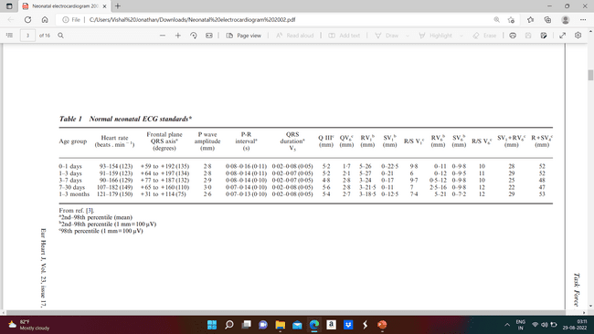
References for ecg
European Heart Journal 2002

Slide 10
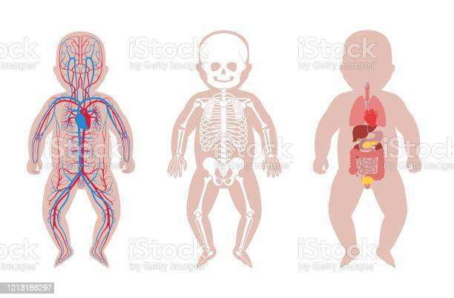
Placement of ecg leads on neonates

Slide 11
Progress – day 3 (27.08.22)
Task Assigned | Struggles Faced | Outcome
Design & develop a case for the POD using 3D Printing | A large number of designs were to be printed by other teams, Time consuming | Obtained the casing for the POD
Design & develop the miniature version of the product before placing it in the casing(POD) | Lack of working space due to flooding with rainwater | Developed the miniature version of the product the next day

Slide 12
Structure of the pod
Dimensions of the pod (Feet): 60 * 30 * 20mm
Dimension of the pod (Chest): 85 * 40 * 20mm

Slide 13
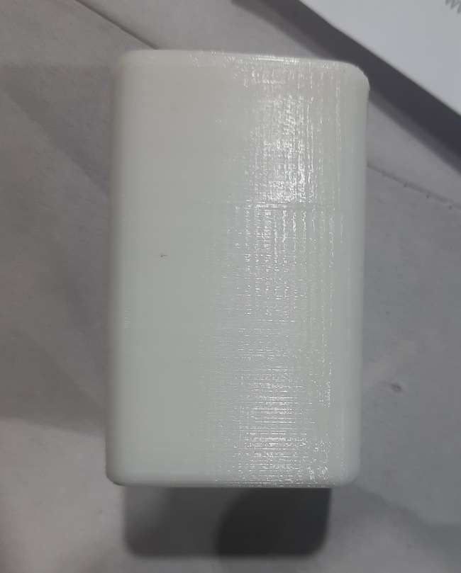
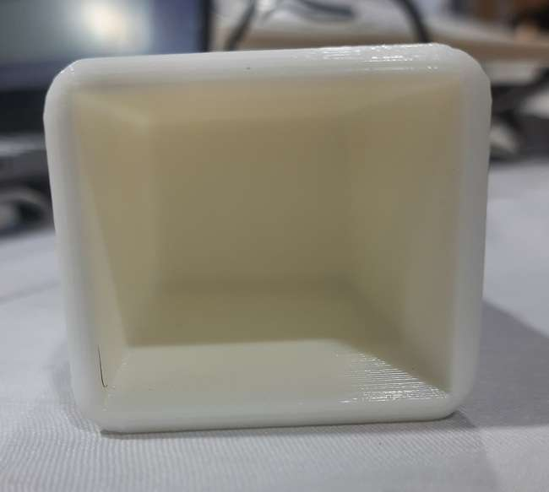
Continued…
POD developed using 3D Printing

Slide 14
Progress – day 4 (28.08.22)
Task Assigned | Struggles Faced | Outcome
Obtain output for SpO2, & an overall result analysis chart | Errors in coding | Successfully eliminated the errors in the code & obtained accurate results for SpO2, presented the overall result analysis chart as expected
Validation | Unable to perform clinical trial for validating ECG readings due to heavy rains | Validated temperature, SpO2 & pulse rate

Slide 15

SpO2 & Heart Rate Output

Slide 16
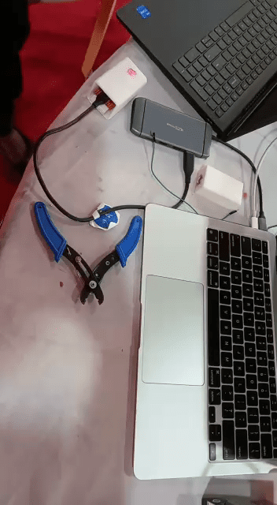
Product validation
Parameter | Normal Range | Instrument Reading | Prototype Reading
Temperature | 35.5 – 36.5 | 36.3 | 35.08
SpO2 | 92 – 100% | 98 | 100
Heart Rate | 120 – 160bpm | 88 | 86

Slide 17
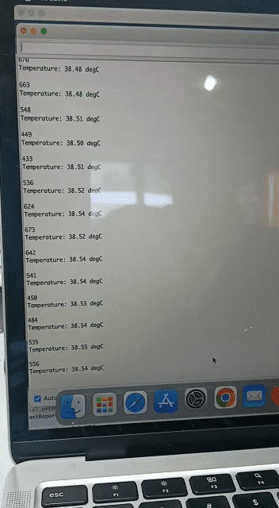
Temperature Reading - Validation

Slide 18
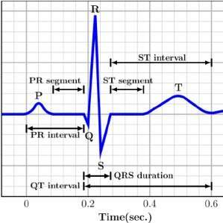
Actual ECG Graph
ECG Graph Readings Obtained

Slide 19
Progress – day 5 (29.08.22)
Task Assigned | Struggles Faced | Outcome
Incorporate sleep apnea from the data obtained from the sensors we are using already | Work on two methods to incorporate sleep apnea | Validation under process
Present the final assembled product with the casing & the respective output | Taking out leads from the pod to measure the parameters | Successfully submitted the working model!!!

Slide 20
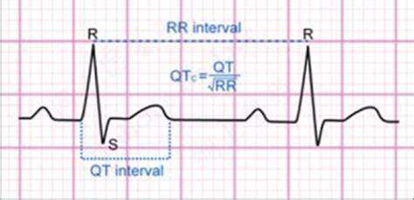
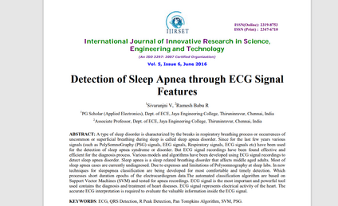
Sleep apnea
A type of sleep disorder - breaks in the respiratory breathing process/ occurrence – uncommon/superficial breathing – sleep – sleep apnea disorder
Last few years – various signals – detection of sleep apnea – ECG Signal recordings – more effective – diagnosis process – efficient
Cyclic variations – duration – heart period – RR Intervals of ECG – reported – associated with sleep apnea disorders.
Reference: International Journal of Innovative Research in Science, Engineering & Technology

Slide 21
BOM
Components Used | Quantity | Rate per item
NodeMCU ESP8266 | 2 | 500/-
AD8232 | 1 | 600/-
MPU6050 | 1 | 900/-
MAX30100 | 1 | 500/-
Total Component Cost of the Unit: 3000/-
Other costs: 100/-

Slide 22
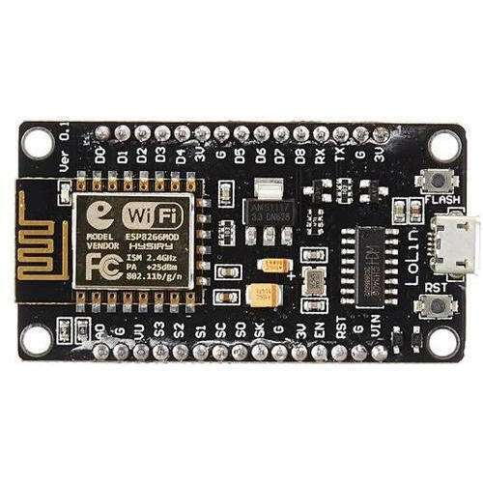
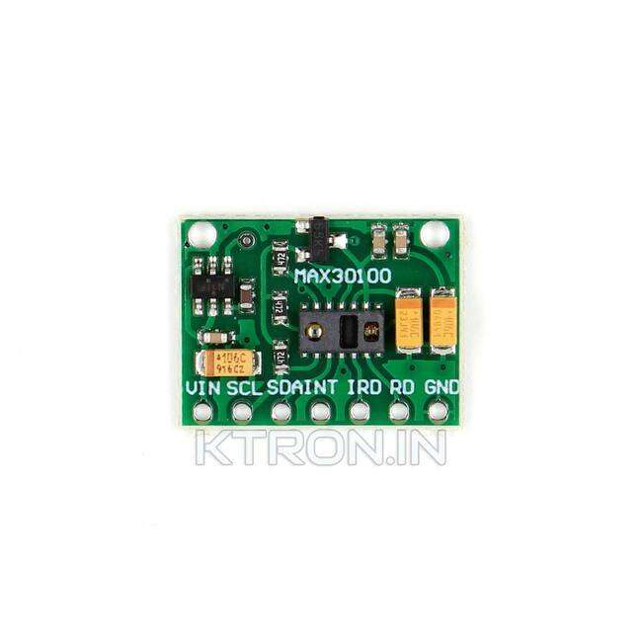
Circuit diagram of the pod to be placed in the feet
Connections:
Ground -----> Ground
Vin ----> 3V3
D0 ----> INT
D1 ----> SCL
D2 ----> SDA

Slide 23
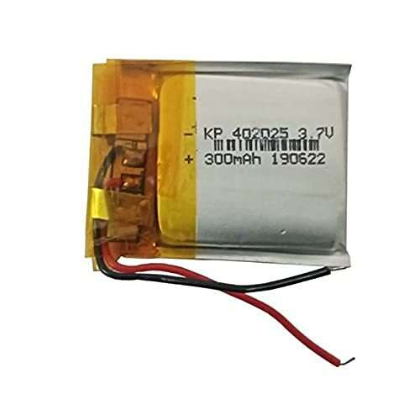
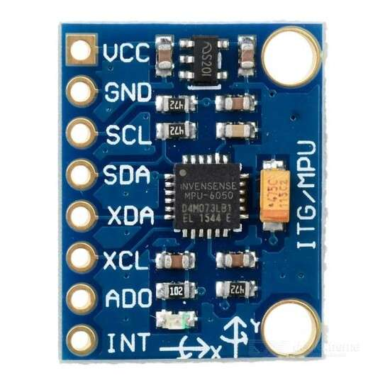
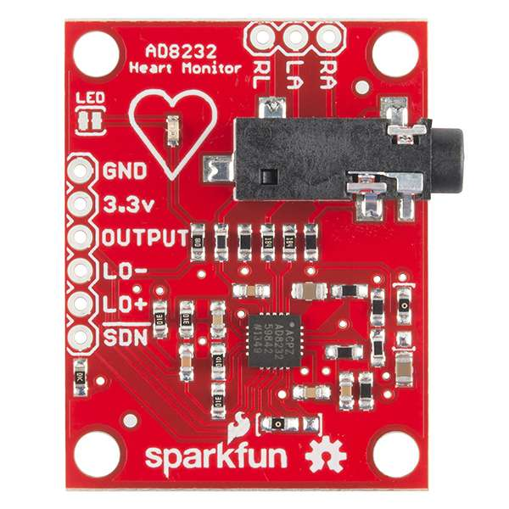
Circuit diagram of the pod to be placed on the chest
Connections:
VCC ----> 3V3; Negative Terminal ----> Ground
Ground ----> Ground; Positive Terminal ----> Vin
D4 ----> LO-
Output ----> A0
D5 ----> LO+
SCL ----> D1
SDA ----> D2

Slide 24







Business plan
Angel Vendors

Slide 25
External References
Dr Charles, Anesthetist
Dr Jaya Balaji, Pediatrician, Velammal Hospital, Madurai

